Slide 1

Bajaj Institute of Technology , Wardha
Group 6 :
Assembly code to shift location of String
Name :Prathamesh Vivek Bhagat
PRN No:2046491245032(232)
Branch: Computer Engineering
Subject:DLDM

Slide 2
Introduction to 8086 and 8085 Microprocessor
8085 is an 8-bit microprocessor designed by Intel in 1977 using NMOS technology.
There are 6 general purpose registers in 8085 processor, i.e. B, C, D, E, H & L. Each register can hold 8-bit data.
8086 Microprocessor is an enhanced version of 8085Microprocessor that was designed by Intel in 1976.
It is a 16-bit Microprocessor having 20 address lines and16 data lines that provides up to 1MB storage

Slide 3
The Problem Statement :
Write a program to move a string of the data words from offset 1000H to offset 3000H the length of the string is 0FH.
That is :The problem is to copy the given string form one memory location to other memory location .

Slide 4
Algorithm :
Copy the given address and destination address (in registers).
Store the size of the string .
Copy one byte data from initial address (to accumulator/register) .
Assign the copied data to destination address (in register).
Increment the initial address and destination address holder register .
Decrement the register holding size of string .
Repeat until the string is complete(stored size of string is 0).

Slide 5
Flow Chart :
Start
SI=1000H
DI=3000H
CX=0FH
AX=[SI]
[DI]=AX
YES
CX>0
SI++
DI++
CX--
NO
End

Slide 6
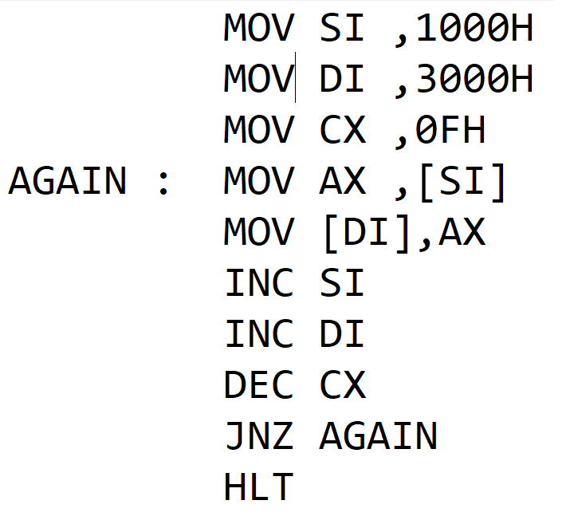
Program Code:

Slide 7
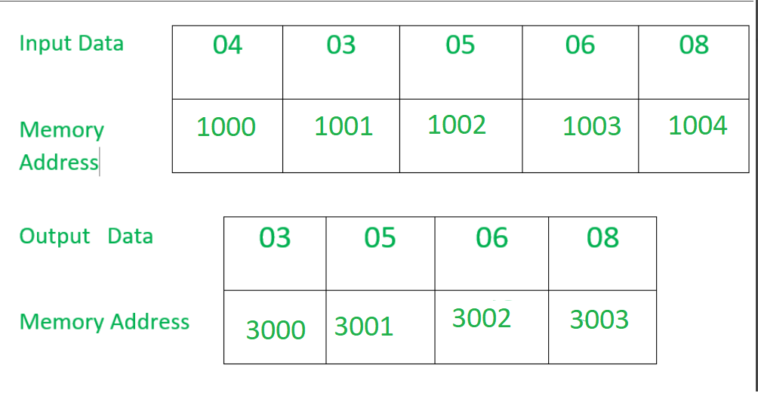
Input /output(Sample):

Slide 8
Thank You

